Slide 1

Software Life
Cycle Models

Slide 2


Software Life Cycle Models
The goal of Software Engineering is to provide models and processes that lead to the production of well-documented maintainable software in a manner that is predictable.

Slide 3



Software Life Cycle Models
“The period of time that starts when a software product is conceived and ends when the product is no longer available for use. The software life cycle typically includes a requirement phase, design phase, implementation phase, test phase, installation and check out phase, operation and maintenance phase, and sometimes retirement phase”.

Slide 4


Build & Fix Model
Product is constructed without specifications or any attempt at design
Build
Code
Adhoc approach and not well defined
Fix
Simple two phase model

Slide 5
Build & Fix Model
Suitable for small programming exercises of 100 or 200 lines
Unsatisfactory for software for any reasonable size
Code soon becomes unfixable & unenhanceable
No room for structured design
Maintenance is practically not possible

Slide 6

Waterfall Model
This model is named “waterfall model” because its diagrammatic representation resembles a cascade of waterfalls.
R
e
q
u
i
r
e
m
e
n
t
Analysis & Specification
Design
I
m
p
l
e
m
e
n
t
a
t
i
o
n
a
n
d
u
n
i
t
t
e
s
t
i
n
g
I
n
t
e
g
r
a
t
i
o
n
a
n
d
s
y
s
t
e
m
t
e
s
t
i
n
g
O
p
e
r
a
t
i
o
n
a
n
d
m
a
i
n
t
e
n
a
n
c
e

Slide 7



Waterfall Model
This model is easy to understand and reinforces the notion of “define before design” and “design before code”.
The model expects complete & accurate requirements early in the process, which is unrealistic

Slide 8


Waterfall Model
Problems of waterfall model
It is difficult to define all requirements at the beginning of a project
This model is not suitable for accommodating any change
A working version of the system is not seen until late in the project’s life
It does not scale up well to large projects.
Real projects are rarely sequential.

Slide 9

Incremental Process Models
They are effective in the situations where requirements are defined precisely and there is no confusion about the functionality of the final product.
After every cycle a useable product is given to the customer.
Popular particularly when we have to quickly deliver a limited functionality system.

Slide 10


Iterative Enhancement Model
This model has the same phases as the waterfall model, but with fewer restrictions. Generally the phases occur in the same order as in the waterfall model, but they may be conducted in several cycles. Useable product is released at the end of the each cycle, with each release providing additional functionality.
Customers and developers specify as many requirements as possible and prepare a SRS document.
Developers and customers then prioritize these requirements
Developers implement the specified requirements in one or more cycles of design, implementation and test based on the defined priorities.

Slide 11

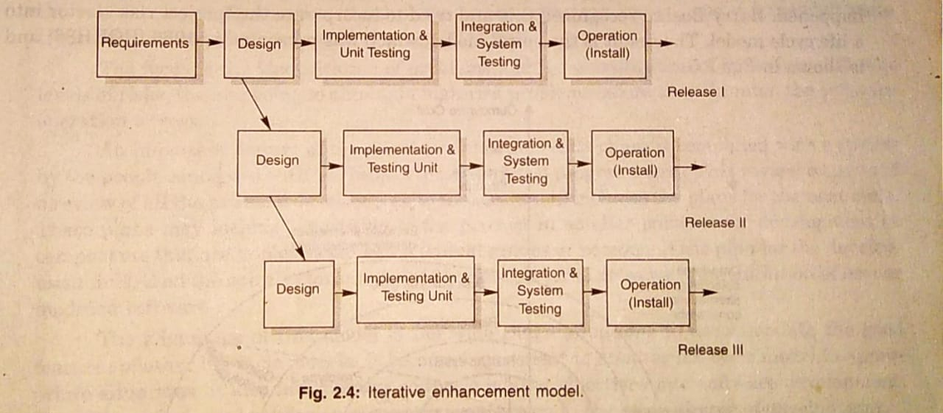

Slide 12

Iterative Enhancement Model
Requirements
specification
Architectural
design
Detailed
design
Implementation
and unit testing
Integration
and testing
Operation and
Maintenance

Slide 13
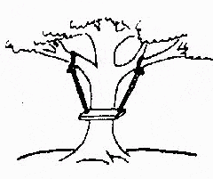

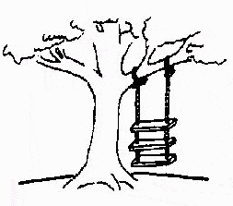
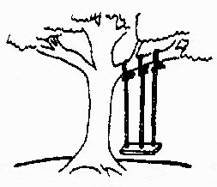
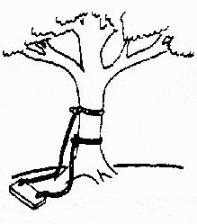
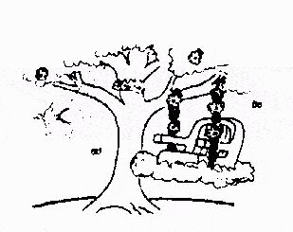
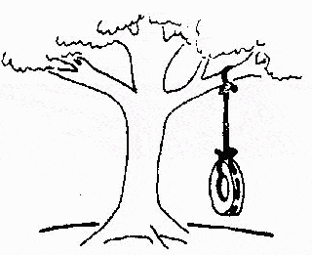
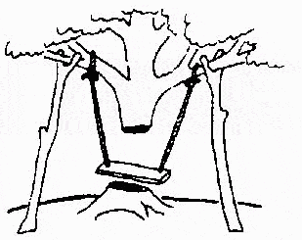
The Rapid Application Development (RAD) Model
Developed by IBM in 1980
User participation is essential
This is how the problem is solved now
The requirements specification was defined like this
The developers understood it in that way
This is how the problem was solved before.
This is how the program is described by marketing department
This, in fact, is what the customer wanted …
That is the program after debugging

Slide 14

The Rapid Application Development (RAD) Model
Build a rapid prototype
Give it to user for evaluation & obtain feedback
Prototype is refined
With active participation of users
Requirements
Planning
User
Description
Construction
Cut over

Slide 15


The Rapid Application Development (RAD) Model
Not an appropriate model in the absence of user participation.
Reusable components are required to reduce development time.
Highly specialized & skilled developers are required and such developers are not easily available.

Slide 16



Evolutionary Process Models
Evolutionary process model resembles iterative enhancement model. The same phases as defined for the waterfall model occur here in a cyclical fashion. This model differs from iterative enhancement model in the sense that this does not require a useable product at the end of each cycle. In evolutionary development, requirements are implemented by category rather than by priority.
This model is useful for projects using new technology that is not well understood. This is also used for complex projects where all functionality must be delivered at one time, but the requirements are unstable or not well understood at the beginning.

Slide 17



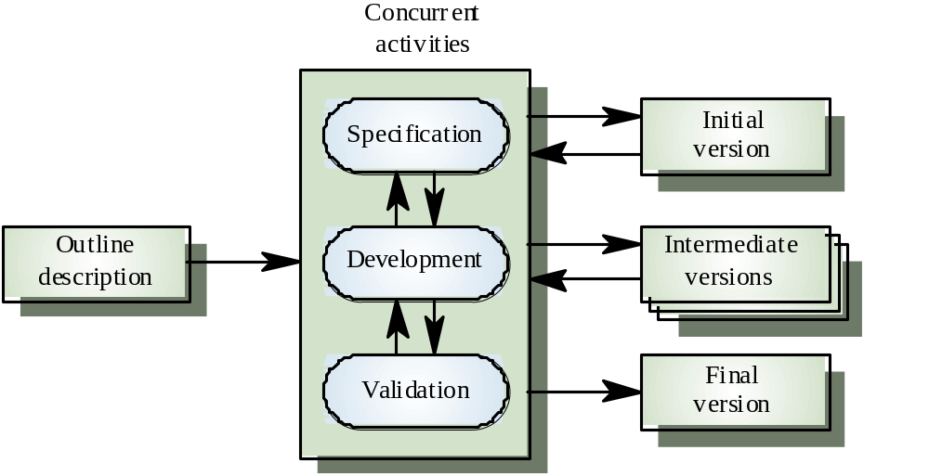
Evolutionary Process Model

Slide 18

Prototyping Model
The prototype may be a usable program but is not suitable as the final software product.
The code for the prototype is thrown away. However experience gathered helps in developing the actual system.
The development of a prototype might involve extra cost, but overall cost might turnout to be lower than that of an equivalent system developed using the waterfall model.

Slide 19
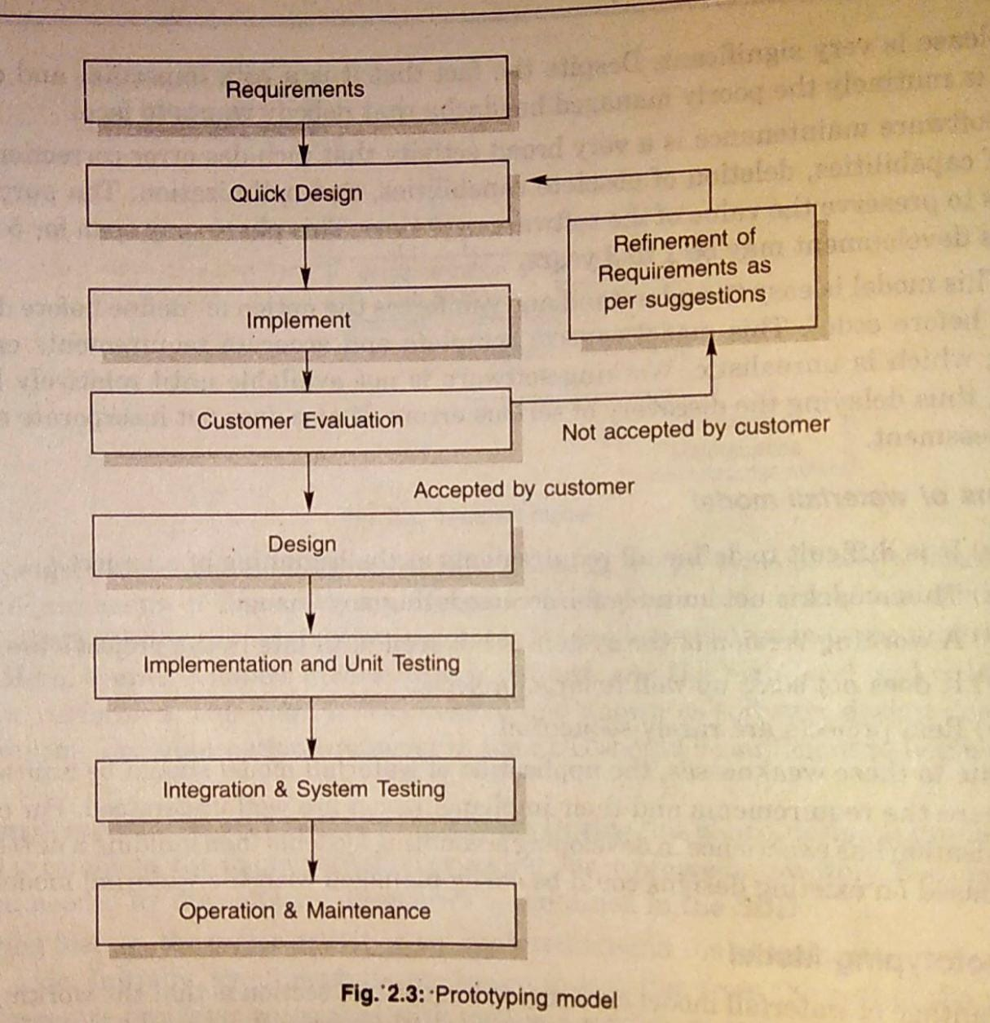

Slide 20



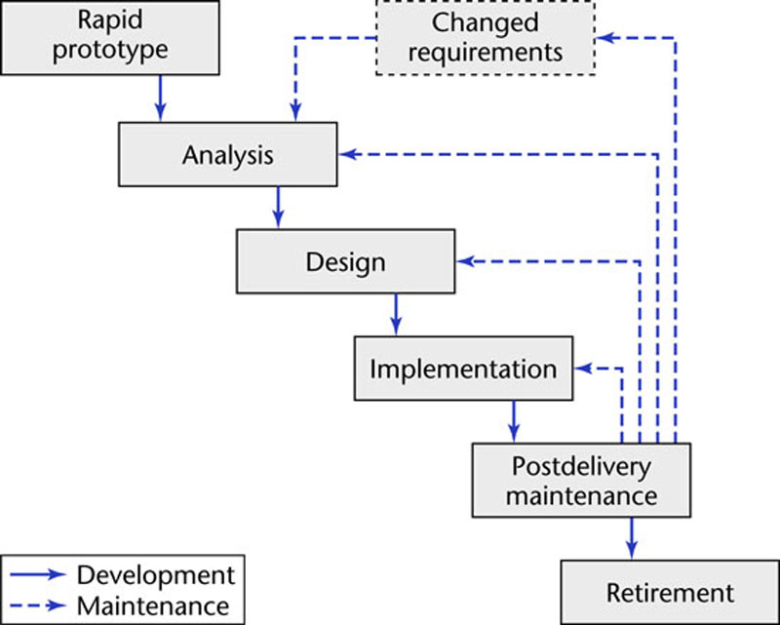
Prototyping Model
Linear model
“Rapid”

Slide 21

Spiral Model
Models do not deal with uncertainly which is inherent to software projects.
Important software projects have failed because project risks were neglected & nobody was prepared when something unforeseen happened.
Barry Boehm recognized this and tired to incorporate the “project risk” factor into a life cycle model.
The result is the spiral model, which was presented in 1986.

Slide 22

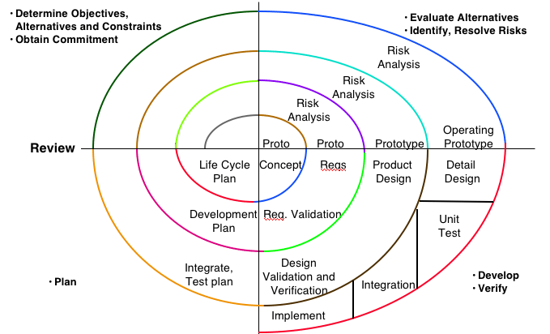
Spiral Model

Slide 23
Spiral Model
The radial dimension of the model represents the cumulative costs. Each path around the spiral is indicative of increased costs. The angular dimension represents the progress made in completing each cycle. Each loop of the spiral from X-axis clockwise through 360º represents one phase. One phase is split roughly into four sectors of major activities.
Planning: Determination of objectives, alternatives & constraints.
Risk Analysis: Analyze alternatives and attempts to identify and resolve the risks involved.
Development: Product development and testing product.
Assessment: Customer evaluation

Slide 24


Spiral Model
An important feature of the spiral model is that each phase is completed with a review by the people concerned with the project (designers and programmers)
The advantage of this model is the wide range of options to accommodate the good features of other life cycle models.
It becomes equivalent to another life cycle model in appropriate situations.
The spiral model has some difficulties that need to be resolved before it can be a universally applied life cycle model. These difficulties include lack of explicit process guidance in determining objectives, constraints, alternatives; relying on risk assessment expertise; and provides more flexibility than required for many applications.

Slide 25

The Unified Process
Developed by I.Jacobson, G.Booch and J.Rumbaugh.
Software engineering process with the goal of producing good quality maintainable software within specified time and budget.
Developed through a series of fixed length mini projects called iterations.
Maintained and enhanced by Rational Software Corporation and thus referred to as Rational Unified Process (RUP).

Slide 26

Phases of the Unified Process
Inception
Elaboration
Construction
Transition
Time
Definition of
objectives
of the project
Planning &
architecture
for the project
Initial
operational
capability
Release of
the Software
product

Slide 27
Phases of the Unified Process
Inception: defines scope of the project.
Elaboration
- How do we plan & design the project?
- What resources are required?
- What type of architecture may be suitable?
Construction: the objectives are translated in design & architecture documents.
Transition : involves many activities like delivering, training, supporting, and maintaining the product.

Slide 28



Initial development & Evolution Cycles
V1
Inception
Elaboration
Construction
Transition
Initial development Cycle
Inception
Elaboration
Construction
Transition
V2
Evolution Cycle
Inception
Elaboration
Construction
Transition
V3
Continue till the product is retired
V1=version1, V2 =version2, V3=version3

Slide 29
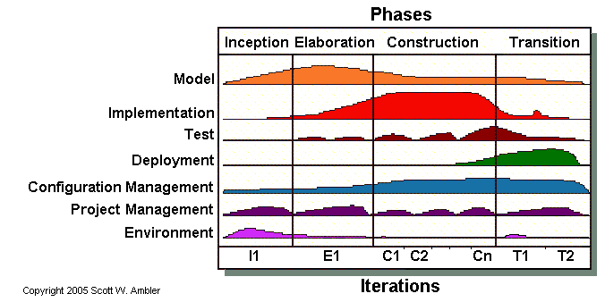

Iterations & Workflow of Unified Process

Slide 30


Inception Phase
The inception phase has the following objectives:
Gathering and analyzing the requirements.
Planning and preparing a business case and evaluating alternatives for risk management, scheduling resources etc.
Estimating the overall cost and schedule for the project.
Studying the feasibility and calculating profitability of the project.

Slide 31



Outcomes of Inception Phase
Project plan
Prototypes
Business
model
Inception
Initial risk
assessment
Initial business
case
Vision
document
Initial use
case model
Initial
project
Glossary

Slide 32

Elaboration Phase
The elaboration phase has the following objectives:
Establishing architectural foundations.
Design of use case model.
Elaborating the process, infrastructure & development environment.
Selecting component.
Demonstrating that architecture support the vision at reasonable cost & within specified time.

Slide 33



Outcomes of Elaboration Phase
Development plan
Revised risk
document
Preliminary
User manual
Elaboration
An executable
architectural
prototype
Architecture
Description
document
Use case
model
Supplementary
Requirements
with non functional
requirement

Slide 34

Construction Phase
The construction phase has the following objectives:
Implementing the project.
Minimizing development cost.
Management and optimizing resources.
Testing the product
Assessing the product releases against acceptance criteria

Slide 35



Outcomes of Construction Phase
Test
Outline
Operational
manuals
Documentation
manuals
Construction
Test Suite
A description
of the
current release
Software
product
User manuals

Slide 36

Transition Phase
The transition phase has the following objectives:
Starting of beta testing
Analysis of user’s views.
Training of users.
Tuning activities including bug fixing and enhancements for performance & usability
Assessing the customer satisfaction.

Slide 37



Outcomes of Transition Phase
Transition
User feedback
Product
release
Beta test reports

Slide 38

Selection of a Life Cycle Model
Selection of a model is based on:
Requirements
Development team
Users
Project type and associated risk

Slide 39

Based On Characteristics Of Requirements
Requirements | Waterfall | Prototype | Iterative enhancement | Evolutionary development | Spiral | RAD
Are requirements easily understandable and defined?
Yes
No
No
No
No
Yes
Do we change requirements quite often?
No
Yes
No
No
Yes
No
Can we define requirements early in the cycle?
Yes
No
Yes
Yes
No
Yes
Requirements are indicating a complex system to be built
No
Yes
Yes
Yes
Yes
No

Slide 40

Based On Status Of Development Team
Development team | Waterfall | Prototype | Iterative enhancement | Evolutionary development | Spiral | RAD
Less experience on similar projects?
No
Yes
No
No
No
Yes
Less domain knowledge (new to the technology)
Yes
No
Yes
Yes
Yes
No
Less experience on tools to be used
Yes
No
No
No
Yes
No
Availability of training if required
No
Yes
Yes
Yes
No
No

Slide 41

Based On User’s Participation
Involvement
of Users
Waterfall
Prototype
Iterative enhancement
Evolutionary development
Spiral
RAD
User involvement in all phases
No
Yes
No
No
No
Yes
Limited user participation
Yes
No
Yes
Yes
Yes
No
User have no previous experience of participation in similar projects
No
Yes
Yes
Yes
Yes
No
Users are experts of problem domain
No
Yes
Yes
Yes
No
Yes

Slide 42

Based On Type Of Project With Associated Risk
Project type
and risk
Waterfall
Prototype
Iterative enhancement
Evolutionary development
Spiral
RAD
Project is the enhancement of the existing system
No
No
Yes
Yes
No
Yes
Funding is stable for the project
Yes
Yes
No
No
No
Yes
High reliability requirements
No
No
Yes
Yes
Yes
No
Tight project schedule
Yes
No
Yes
Yes
Yes
Yes
Use of reusable components
No
Yes
No
No
Yes
Yes
Are resources (time, money, people etc.) scare?
No
Yes
No
No
Yes
No

Slide 43
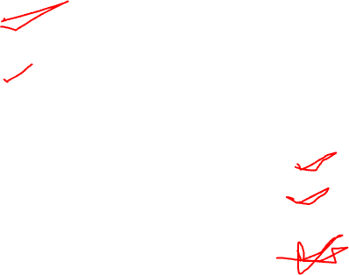


Multiple Choice Questions
Note: Select most appropriate answer of the following questions:
2.1 Spiral Model was developed by
(a) Bev Littlewood (b) Berry Boehm
(c) Roger Pressman (d) Victor Basili
2.2 Which model is most popular for student’s small projects?
(a) Waterfall model (b) Spiral model
(c) Quick and fix model (d) Prototyping model
2.3 Which is not a software life cycle model?
(a) Waterfall model (b) Spiral model
(c) Prototyping model (d) Capability maturity model
2.4 Project risk factor is considered in
(a) Waterfall model (b) Prototyping model
(c) Spiral model (d) Iterative enhancement model
2.5 SDLC stands for
(a) Software design life cycle (b) Software development life cycle
(c) System development life cycle (d) System design life cycle

Slide 44
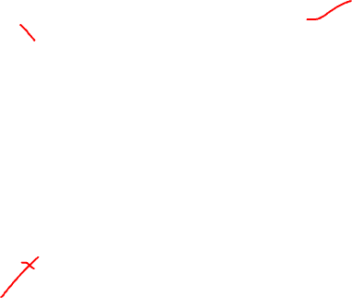
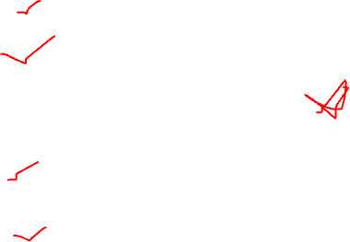
Multiple Choice Questions
Note: Select most appropriate answer of the following questions:
2.6 Build and fix model has
(a) 3 phases (b) 1 phase
(c) 2 phases (d) 4 phases
2.7 SRS stands for
(a) Software requirements specification (b) Software requirements solution
(c) System requirements specification (d) none of the above
2.8 Waterfall model is not suitable for
(a) small projects (b) accommodating change
(c) complex projects (d) none of the above
2.9 RAD stands for
(a) Rapid application development (b) Relative application development
(c) Ready application development (d) Repeated application development
2.10 RAD model was proposed by
(a) Lucent Technologies (b) Motorola
(c) IBM (d) Microsoft

Slide 45
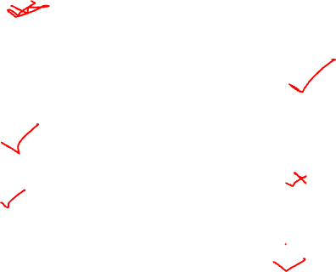
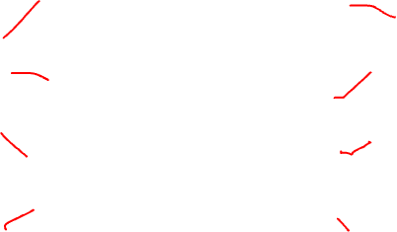
Multiple Choice Questions
Note: Select most appropriate answer of the following questions:
2.11 If requirements are easily understandable and defined,which model is best suited?
(a) Waterfall model (b) Prototyping model
(c) Spiral model (d) None of the above
2.12 If requirements are frequently changing, which model is to be selected?
(a) Waterfall model (b) Prototyping model
(c) RAD model (d) Iterative enhancement model
2.13 If user participation is available, which model is to be chosen?
(a) Waterfall model (b) Iterative enhancement model
(c) Spiral model (d) RAD model
2.14 If limited user participation is available, which model is to be selected?
(a) Waterfall model (b) Spiral model
(c) Iterative enhancement model (d) any of the above
2.15 If project is the enhancement of existing system, which model is best suited?
(a) Waterfall model (b) Prototyping model
(c) Iterative enhancement model (d) Spiral model

Slide 46
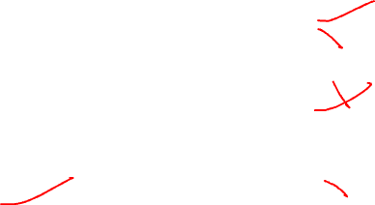
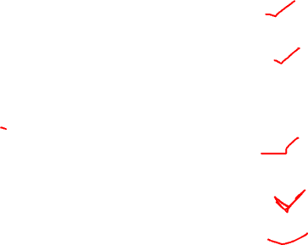
Multiple Choice Questions
Note: Select most appropriate answer of the following questions:
2.16 Which one is the most important feature of spiral model?
(a) Quality management (b) Risk management
(c) Performance management (d) Efficiency management
2.17 Most suitable model for new technology that is not well understood is:
(a) Waterfall model (b) RAD model
(c) Iterative enhancement model (d) Evolutionary development model
2.18 Statistically, the maximum percentage of errors belong to the following phase of SDLC
(a) Coding (b) Design
(c) Specifications (d) Installation and maintenance
2.19 Which phase is not available in software life cycle?
(a) Coding (b) Testing
(c) Maintenance (d) Abstraction
2.20 The development is supposed to proceed linearly through the phase in
(a) Spiral model (b) Waterfall model
(c) Prototyping model (d) None of the above

Slide 47


Multiple Choice Questions
Note: Select most appropriate answer of the following questions:
2.21 Unified process is maintained by
(a) Infosys (b) Rational software corporation
(c) SUN Microsystems (d) None of the above
2.22 Unified process is
(a) Iterative (b) Incremental
(c) Evolutionary (d) All of the above
2.23 Who is not in the team of Unified process development?
(a) I.Jacobson (b) G.Booch
(c) B.Boehm (d) J.Rumbaugh
2.24 How many phases are in the unified process?
(a) 4 (b) 5
(c) 2 (d) None of the above
2.25 The outcome of construction phased can be treated as:
(a) Product release (b) Beta release
(c) Alpha release (d) All of the above

Slide 48
Exercises
2.1 What do you understand by the term Software Development Life Cycle (SDLC)? Why is it important to adhere to a life cycle model while developing a large software product?
2.2 What is software life cycle? Discuss the generic waterfall model.
2.3 List the advantages of using waterfall model instead of adhoc build and fix model.
2.4 Discuss the prototyping model. What is the effect of designing a prototype on the overall cost of the project?
2.5 What are the advantages of developing the prototype of a system?
2.6 Describe the type of situations where iterative enhancement model might lead to difficulties.
2.7 Compare iterative enhancement model and evolutionary process model.

Slide 49
Exercises
2.8 Sketch a neat diagram of spiral model of software life cycle.
2.9 Compare the waterfall model and the spiral model of software development.
2.10 As we move outward along with process flow path of the spiral model, what can we say about software that is being developed or maintained.
2.11 How does “project risk” factor effect the spiral model of software development.
2.12 List the advantages and disadvantages of involving a software engineer throughout the software development planning process.
2.13 Explain the spiral model of software development. What are the limitations of such a model?
2.14 Describe the rapid application development (RAD) model.Discuss each phase in detail.
2.15 What are the characteristics to be considered for the selection of the life cycle model?

Slide 50
Exercises
2.16 What is the role of user participation in the selection of a life cycle model?.
2.17 Why do we feel that characteristics of requirements play a very significant role in the selection of a life cycle model?
2.18 Write short note on “status of development team” for the selection of a life cycle model?.
2.19 Discuss the selection process parameters for a life cycle model.
2.20 What is unified process? Explain various phases along with the outcome of each phase.
2.21 Describe the unified process work products after each phase of unified process.
2.22 What are the advantages of iterative approach over sequential approach? Why is unified process called as iterative or incremental?

